Slide 1

Unit 9
Chinese Food
Written by T.McArthur
Instructor： Xu Xiao fang

Slide 2
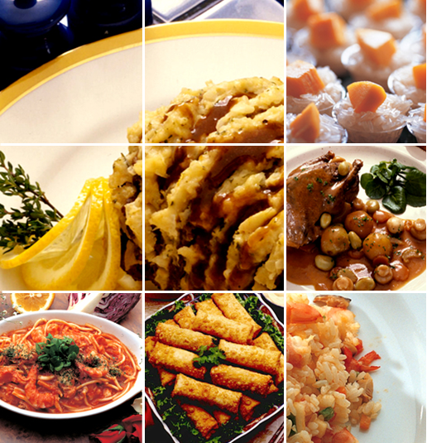
Giving a talk
Topic:
Chinese food & Chinese eating culture

Slide 3

Review
Going to a restaurant
Westerns
Chinese
a small room with
plain walls
a good table
a social lubricant
serious business
eating seems to be the
by-product
eating with a capital E

Slide 4
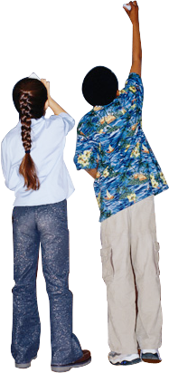
Review
Westerners
indifferent to food
simply a fuel
Chinese
attach primal importance to food
ultimate moral effect

Slide 5
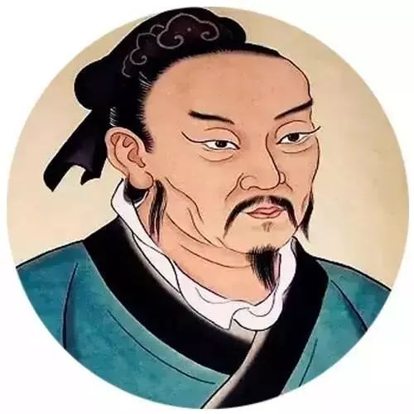
Quotations
A man of virtue will never go anywhere near the kitchen, because he doesn’t want to hear the killing of animals.
见其生，不忍见其死；闻其声，不忍食其肉，是以君子远庖厨也。
—— 《孟子．梁惠王上》
Food is the first happiness.
民以食为天。
——《汉书．郦食其传》

Slide 6
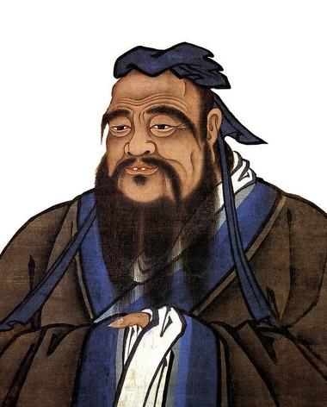
Quotations
He didn’t dislike to have his rice finely cleaned, nor to have his minced meat cut quite small.
食不厌精，脍不厌细。
—— 《论语—乡党篇》
If people have enough food supply stored in granaries, they will pay attention to etiquettes. If people are not short of food and clothes, they will lay stress on the sense of honor and shame.
仓廪实而知礼节，衣食足而知荣辱。
—— 《管子·牧民》

Slide 7
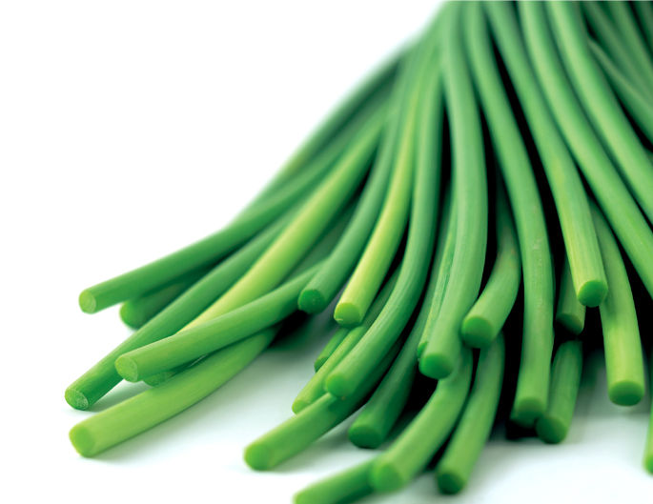
Brain-storming
cooking methods
Cutting methods
eight schools
Food
ingredients
morality, etiquettes, spirits……

Slide 8
Blank-Filling
Chinese cuisine is the product of the traditional Chinese _________,which is profoundly ______ from Westerns’ and _________________,
deriving from_______________________.
philosophy
different
typically Chinese
thousands of years of tradition

Slide 9
Warming –up
In her essay “Who Can Tell My Story?” Jacqueline Woodson, an African American writer, speaks about people outside her home culture writing without true knowledge and insight.
Is it possible for “outsiders” to write with understanding about a culture? How do you feel when people on the outside write your culture?

Slide 10
This article, which is written by a foreigner, provides us with a _______ perspective to examine our culture, though on a seemingly trivial aspect ——_____________. But all elements of a culture are actually of equal significance, so any of them can serve as a stand we set our first step on. If you haven’t started your journey to discover your own culture, then let yourself be pushed by this article and take it as your first step. At the end of this journey, you may either love your culture more, or less, but one thing is sure, that your feeling toward your culture will be more real and will be based upon a much _________ view.

Slide 11
Para.5
What has helped the spread of Chinese food to the rest of the world?
Firstly, after 1950s, Emigrants from Hong Kong opened
restaurants in various places.
Secondly, Western people have become interested
in the pursuit of sensual pleasures( which is abundant
in Chinese food).

Slide 12
Video-watching
How did Lily start her business?
What was the name of the restaurant? What was it like? ( location, decoration/environment, target customers，food）
What difficulties did the lady meet when she started up her business?

Slide 13
Understanding of the text
They settled on or near the west coast, where the famous — or infamous — “chop suey joints” grew up, with their rather inferior brand of Chinese cooking.(para.6)
Paraphrase:
Earlier Chinese settlers cooked food like “chop suey joints”, which labeled Chinese cooking as lower-class type.
causing an evil reputation

Slide 14
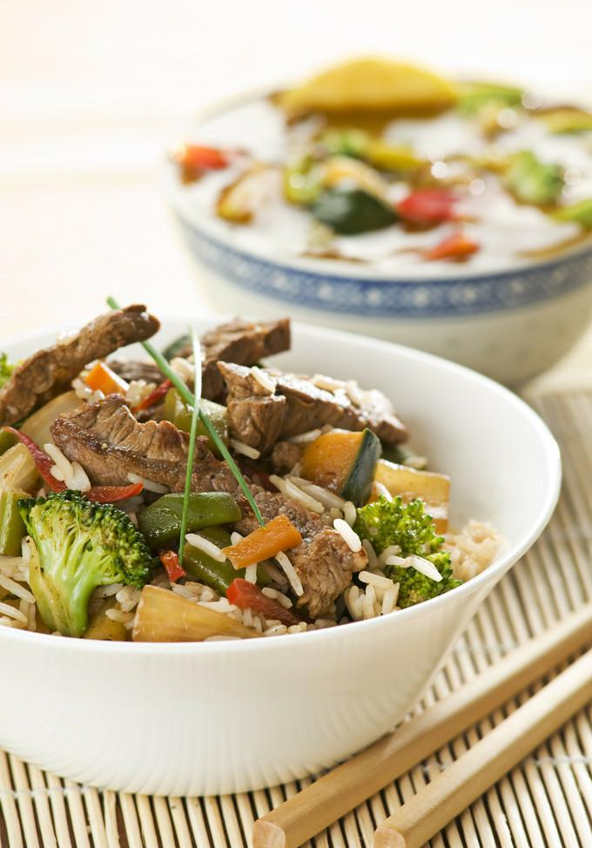
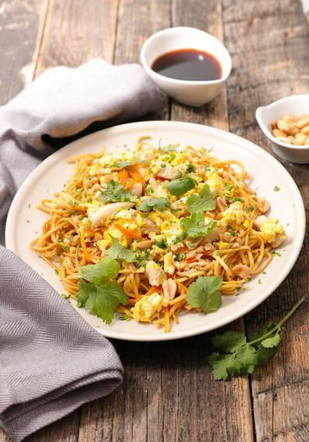
Chop Suey Joints
Chow Mien

Slide 15
Discussion
What can we learn from her story?
Character
Efforts
signal
creative
Intelligent
Hard-working
an inspiration to people with marginalized identities.
bring real
Chinese food to foreigners

Slide 16
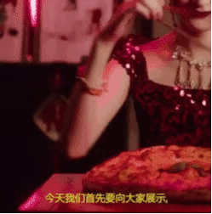
Cultural Confidence

Slide 17
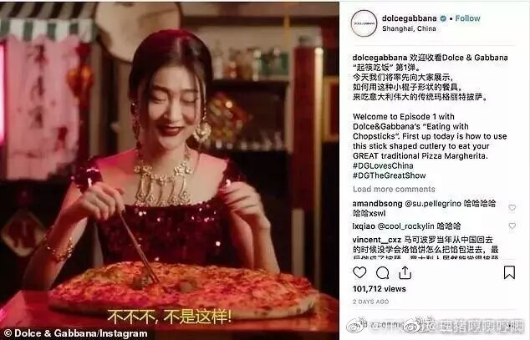

Slide 18
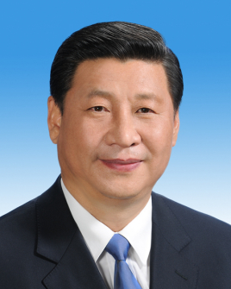
Cultural Confidence
Outstanding traditional culture is the root of the heritage and development of a country and a nation. Renouncing it is tantamount to serving our cultural lifeline. We should learn how to best carry forward our fine cultural traditions, and at the same time promote contemporary culture. We should put emphasis on both inheriting and development.
—— Transform and Boost Traditional Culture
in a Creative Way, September 24, 2014

Slide 19
Summary
A time-honored dietary habit of an agricultural society
Chinese Food
An inspiration to people with marginalized identities
The product of the traditional Chinese philosophy

Slide 20
Assignments
1. Discussion
Topic: Do you think the art of Chinese cooking will be passed on to later generations and spread to different parts of the world? What can we do to inherit and develop it?
2. Listening
Listen to the recording from VOA, write down as many idioms about food as possible.
3. Reading
Read the essay “eating and drinking” excerpted from Lin Yutang’s My Country and My people.

Slide 21

Thank You !

