Slide 1
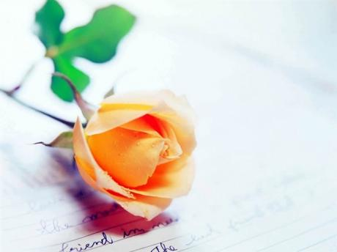

Whatever happened to manners ?

Slide 2
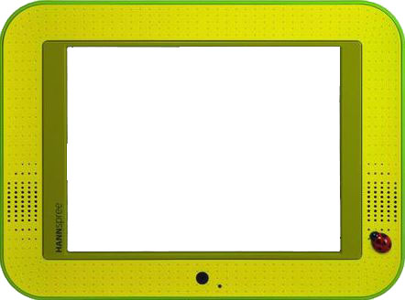
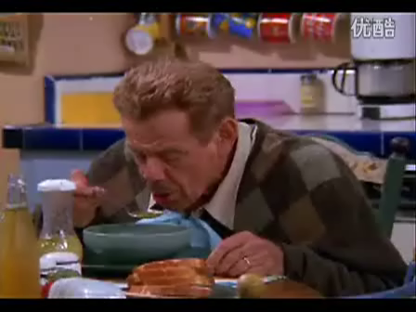
Step 1 Lead-in

Slide 3
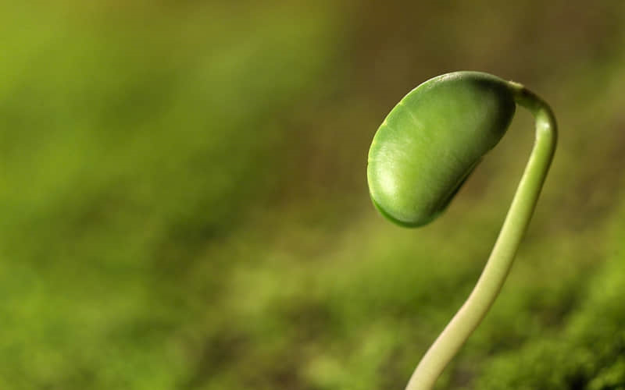
Lead-in questions
1. What do you think are good manners? Are you a person with good manners?
2. List good manners and bad manners in daily life.

Slide 4

Step 1 Lead-in
Table Manners: Do/Don’t
1. _____ take a sip of your drink while still chewing.
Don’t
2. _____ apply lipstick at the table after a meal.
Don’t
3. ____ use the napkin to gently wipe your mouth.
Do

Slide 5
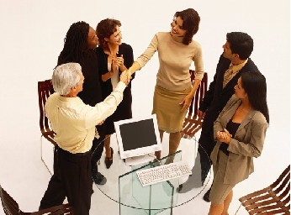
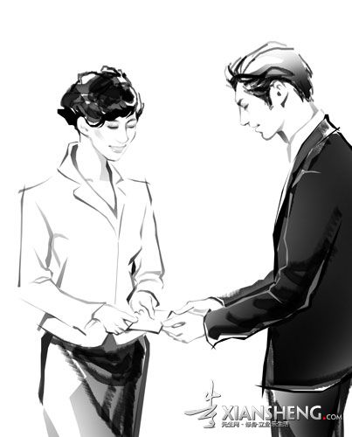
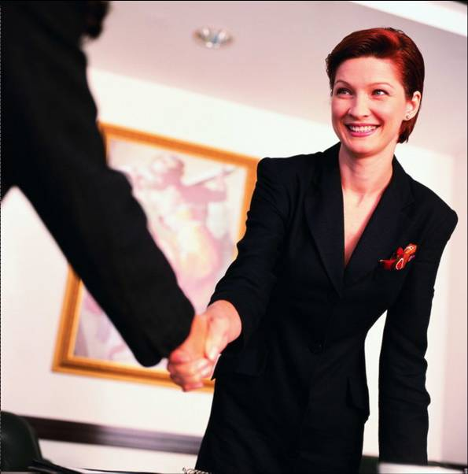
Business Etiquette
Step 1 Lead-in
smile
eyes
Wear a ________ on your face.
Receive the business card with___________.
Look into others’ _____ during the handshake.
both hands

Slide 6
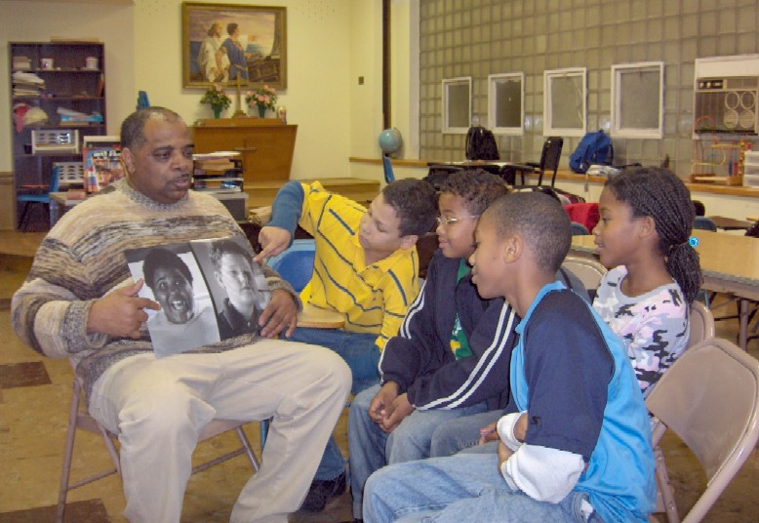
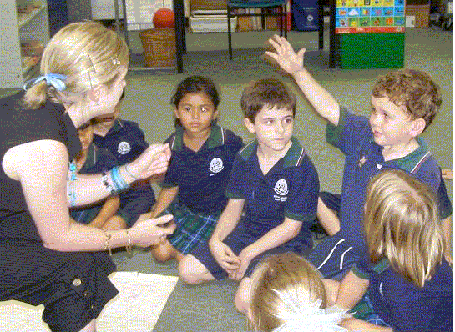
Step 1 Lead-in
Classroom Politeness
When the teacher is speaking, we should……
When we want to express ourselves，we should……

Slide 7
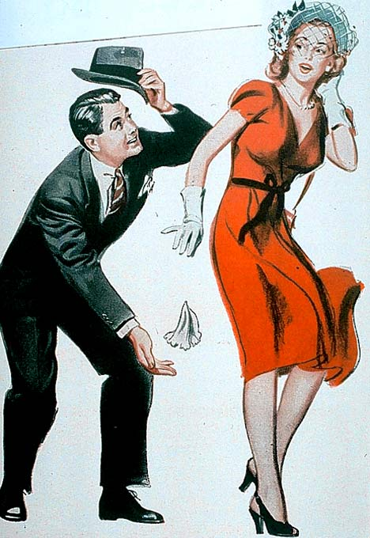
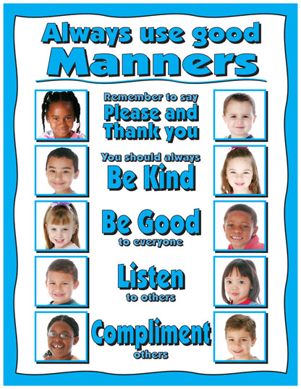

Slide 8
Learning Objectives
To explore the main structure
To understand the main idea
To foster good social skills

Slide 9
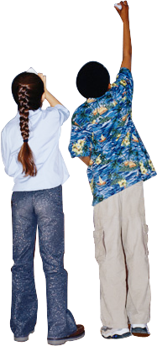
Teaching Procedures
Lead-in
Global Reading
Detailed Reading
Summary
Extension

Slide 10
Global Reading
What type of writing is this essay?
  Narration
  Description
  Argumentation
  Exposition
  …
An argumentation
The type of writing in which writers try to encourage readers to accept their point of view on a controversial issue.
In argumentation, writers use objective, logical reasoning, facts and evidence to demonstrate the soundness of a position.

Slide 11
Argumentation
Aim:
  Exposition: inform;
  Argumentation: convince
What’s involved …
  ≠ quarrel
  a controversial issue – the viewpoint
  The logical appeal
  The emotional appeal
  Sufficient evidence

Slide 12
Structural Analysis
Introduction
The author puts forward a fact that ___________________
_______________________.
Para( )
nowadays, many people
1
Show a lack of good manners manners
The author raises and proves her opinion that __________
_______________________.
Good manners
Para( )
2-4
Body
are a sort of hidden beauty secret
The author points out and illustrates that ___________
_______________________.
The influences
Para( )
5-10
of some specific good manners
Conclusion
Para( )
The author concludes that _______________________
11
Good Manners are infectious.

Slide 13


Detailed Reading
Para.1
beginning of the essay
Impolite examples:
rushing into elevators without giving those inside a chance to get off first
never saying “thank you” when others hold a door open for them
never saying “please” when they want a coworker to hand them something
never giving a wave or nod of appreciation when another motorist lets them pull out into traffic

Slide 14
Detailed Reading
Para.1
I feel that much of the world…gotten away from that.
I feel that many people in the contemporary world are, for some reason or other, not as nice, not as friendly, or not as polite with one another as people in the past..

Slide 15

Detailed Reading
Para.1
The loss of good manners
-- Why do you think good manners are gradually abandoned by the main stream?

Slide 16
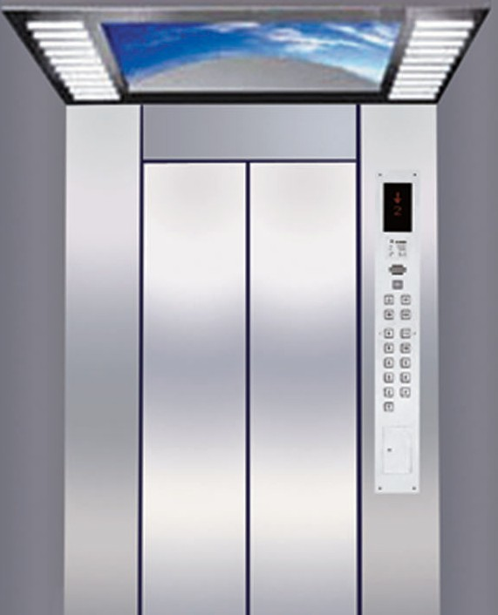
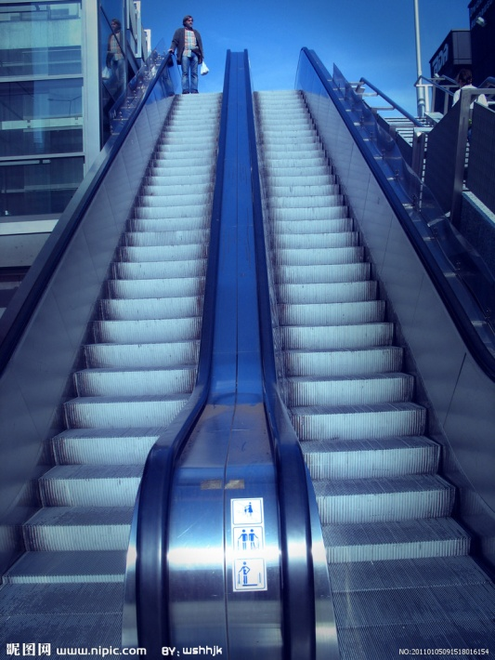
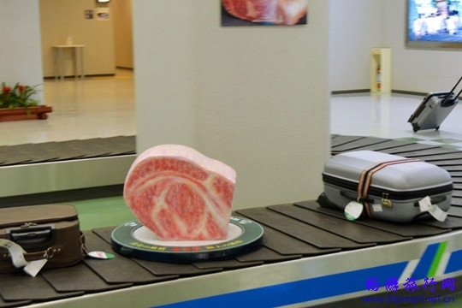
Detailed reading
Elevator
  = lift
  escalator
  conveyor

Slide 17
Detailed Reading
Para.1
appreciation
(1) an understanding of the good qualities or worth of sth.
As soon as she finished singing a beautiful song, the audience burst our cheering to show their appreciation.
(2) a judgment of the worth or facts of sth.
That statesman gave a realistic appreciation of the current situation at home of abroad.

Slide 18
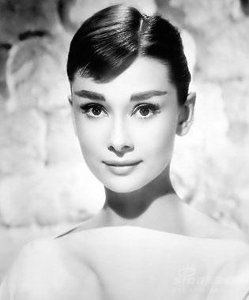
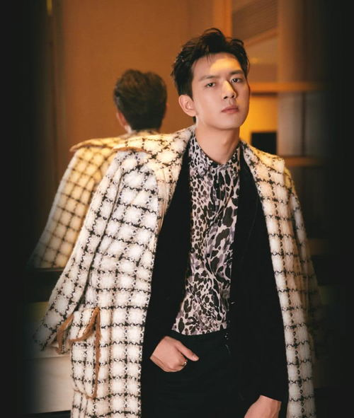
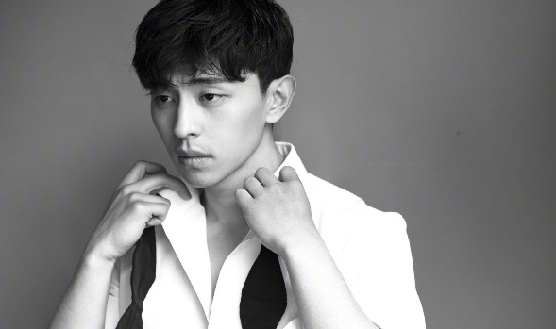
Detailed Reading
Para.2-4
fashionable, elegant and attractive
According to the writer, how do good manners build up our images?
  How do you understand this: “we can’t be truly stylish without good manners”?
  Are there really any connections between manners and appearance? How do you comprehend appearance?

Slide 19
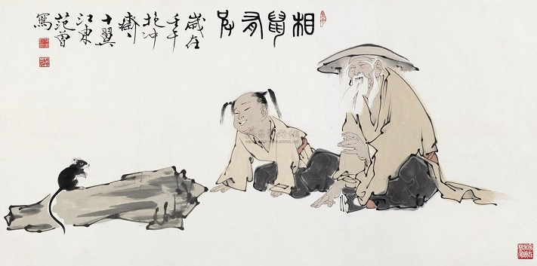
Detailed Reading
相鼠有体，人而无礼！
人而无礼，胡不遄死？
----《诗经·相鼠》
看那老鼠还有体，做人反而不守礼。做人如果不守礼，赶快去死别迟疑。

Slide 20
Detailed Reading
I think of good manners as a sort of hidden beauty secret.
I regard good manners as a kind of concealed magic method or formula which makes you beautiful.

Slide 21
Detailed Reading
What example does the writer use to
prove good manners are a sort of
hidden beauty secret?
The kindest most generous people seem to keep getting prettier. They become Cary Grant or Lauren Bacall right before our eyes.

Slide 22
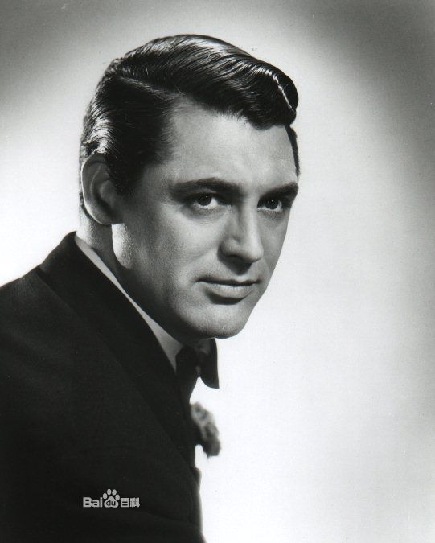
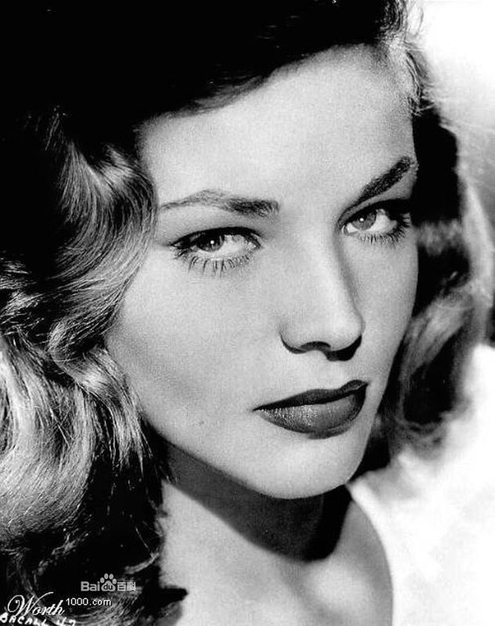
Detailed Reading
The power of HOW YOU BEHAVE
  Cary Grant & Lauran Bacall

Slide 23
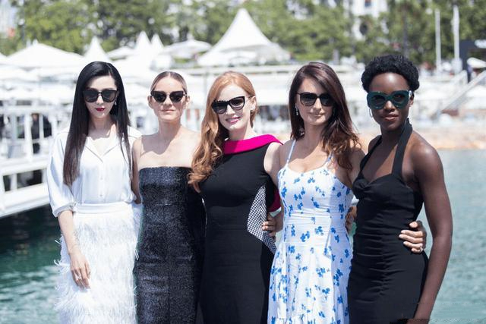
Detailed Reading
According to the author, which of the
following way can make us feel better
about ourselves?
To wear a little lipstick
To make sure our hair is neat
To say “Thank you” habitually

Slide 24
Detailed Reading
…but it adds priceless panache to your image.
… but a kind, gracious manner makes you look much more stylish and admirable, contributing invaluably to your image.

Slide 25
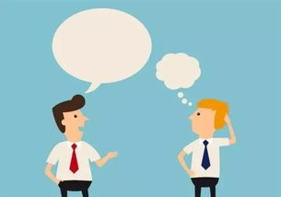
Detailed Reading
Dialogue Making
Directions: Make a dialogue with your partner. You are supposed to use the following words and phrases as many as possible.
appreciate, appreciation, get away, somehow, pull out
gracious, priceless, panache, precious

Slide 26
Detailed Reading
Para.5-10
What good manners does the writer suggest that we should display?
Do you agree with the author that good manners with our families count the most? Justify your point.

Slide 27
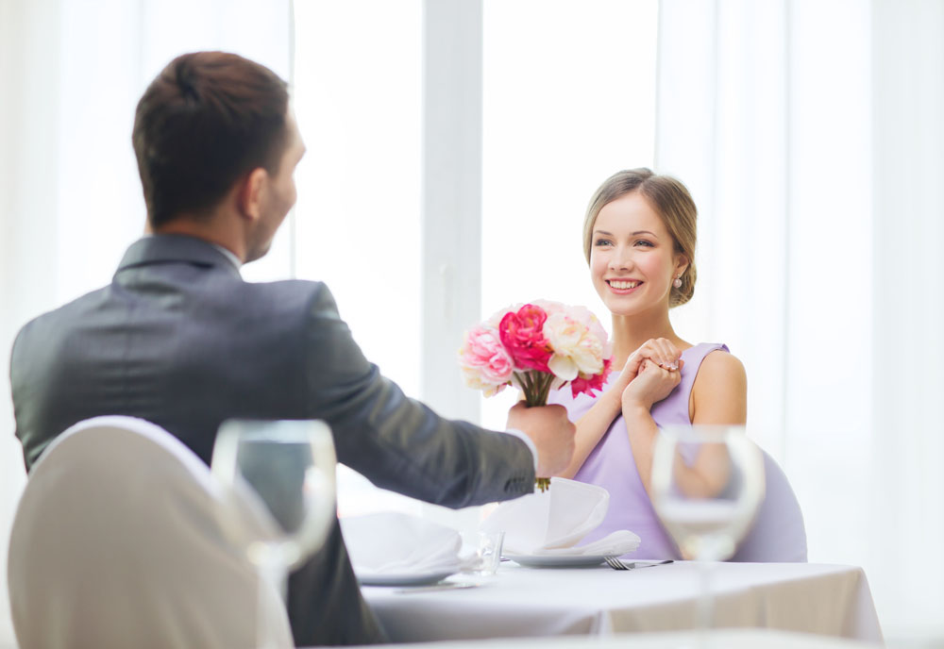
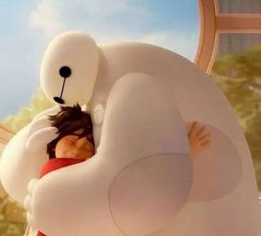
Detailed Reading
Positive Thanking

Slide 28
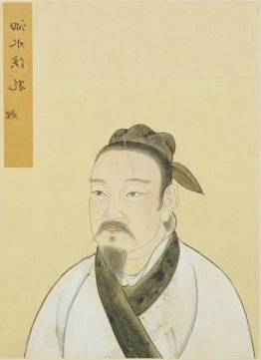
Detailed Reading
Manners with the families
  Kong Li passing the court
  尝独立，鲤趋而过庭。曰：‘学诗乎？’对曰：‘未也’。‘不学诗，无以言。’鲤退而学诗。他日又独立，鲤趋而过庭。曰：‘学礼乎？’对曰：‘未也’。‘不学礼，无以立。’鲤退而学礼。
  How do we treat the traditional notion of manners with families in China?

Slide 29
Detailed Reading
Of course, saying “Thank you.” does wonders for the person on the receiving end too.
Without doubt/surely/certainly, saying “Thank you.” will bring benefit to the person who receives the thank-you remark.

Slide 30

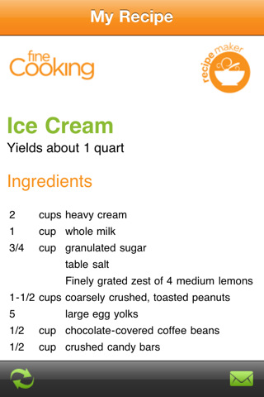
Detailed Reading
Positive Thanking
A thank-you note
A recipe for a dish
It was a _____ gesture that
made me feel ______ and ___________ ______.
sweet
terrific
put me in a great mood

Slide 31
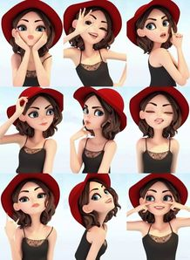
Detailed Reading
Gesture is a form of body language which include movement of the hands, face, or other parts of the body.

Slide 32
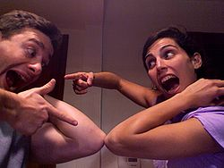
Detailed Reading
The elbow bump （撞肘），is an informal greeting where two people touch, or tap elbows.

Slide 33
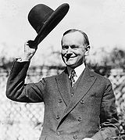
Detailed Reading
A hat tip, or doff (British English), is a cultural expression of recognition, respect, gratitude, greeting, or simple salutation and acknowledgement between two persons.

Slide 34
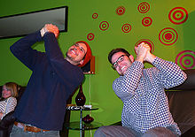
Detailed Reading
A victory clasp is a double hand gesture used in celebration of one's own victory. Both hands are clasped together and shaken side to side for as long as the victory merits..

Slide 35
Detailed Reading
If you feel like a feel because you’ve put off sending a card, ... (L3, Para. 6)
If you’d like to know how you would
feel when you do write a thank-you
note.

Slide 36

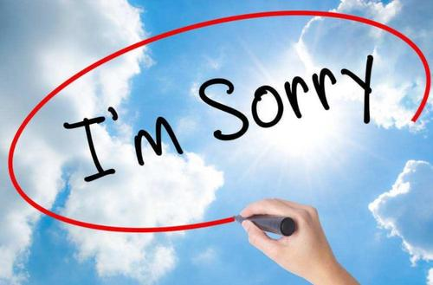
Magic Words

Slide 37
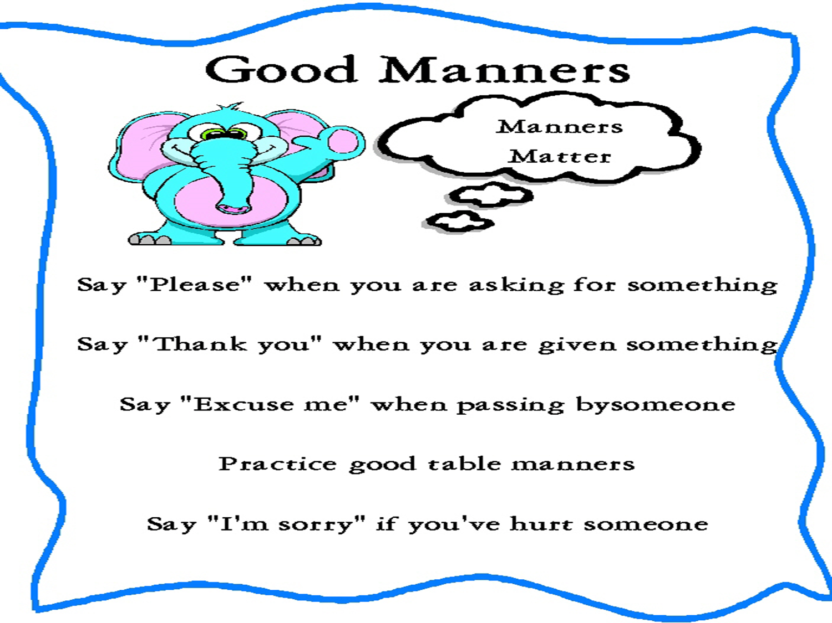
Detailed Reading
Cite some “magic words” that may
bring people closer?

Slide 38
Just as powerful as a thank-you note is the simple phrase “Excuse me.” (L1, Para.7)
inverted sentence
The normal order is:
The simple phrase “Excuse me” is just as powerful as a thank-you note.

Slide 39
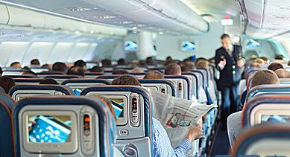

Detailed Reading
Magic Words
When someone knocks an enormous carry-on bag into your head when he’s barreling down the aisle and doesn’t bother to say he’s sorry……
Barrel down: a figurative expression:
move quickly

Slide 40
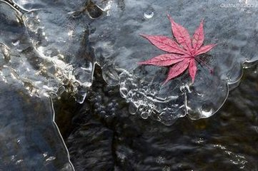
Detailed Reading
When someone does stop and turn around and genuinely apologize……
It melt away most of the irritation you felt.
Melt away: a figurative expression:

Slide 41
Detailed Reading
…doesn‘t it melt away most ― if not all
― of the irritation you felt? (L5, Para.7）
After you hear someone’s genuine apology, most ― if not all ― of your irritation will naturally disappear.
This is a rhetorical question which need not be answered and which must be uttered in a falling tone. A negative rhetorical question is close in meaning to but more powerful in tone than a positive statement.

Slide 42
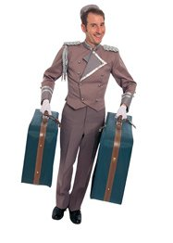
Detailed Reading
He will appreciate a little gesture from you that makes his life a wee bit easier.

Slide 43
Detailed Reading
Just because his job is to carry my bags doesn’t mean he doesn’t appreciate a little gesture that makes his life a wee bit easier. (L2, Para. 8)
just because: only for the reason that…
I have to leave just because my employment contract expired.
Is she promoted just because she gets on well with everybody?

Slide 44
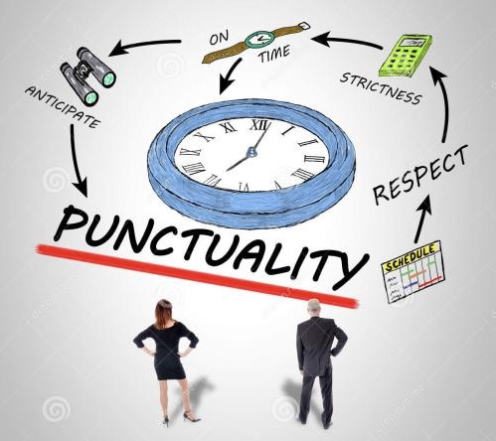
Detailed Reading
Punctuality is not a thing of the past.

Slide 45
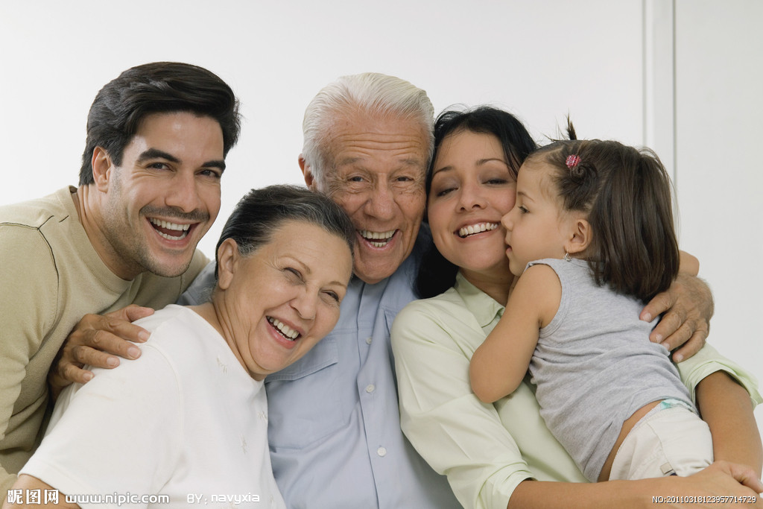
Detailed Reading
Bringing Manners Home

Slide 46
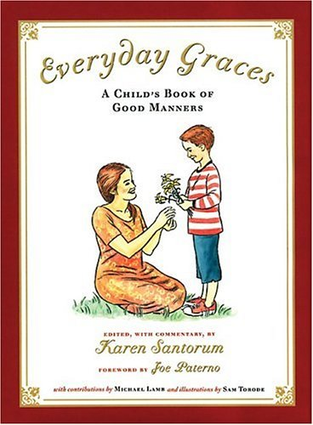
Detailed Reading
Do you agree with the writer that good manners with our families count the most?

Slide 47

Detailed Reading
for heaven’s sake: 看在上帝的份上
for God's sake
for goodness' sake
for Pete’s sake
It can be used when one asks strongly for something.
For heaven’s sake, don’t let her know what I told you!

Slide 48

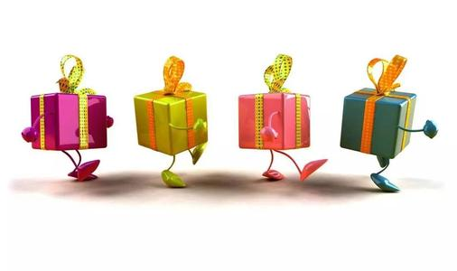
Detailed Reading
That’s where is counts the most because those
are the people we love the most.
To say “Thank you” or “I love you” to your spouse
Bringing home the most insignificant little presents for people you cherish

Slide 49
Detailed Reading
Similarly, bringing home the most insignificant little presents for people you cherish will go a long way. (L1,Para.10)
Where is the predicate of the sentence?
produce wonderful effects;
bring about very good results;
lead to gratifying effects;
e.g. A nice polite introduction can go a long way.
It will go a long way towards success.
它将有助于获得成功。

Slide 50
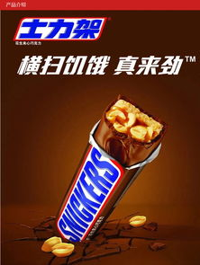
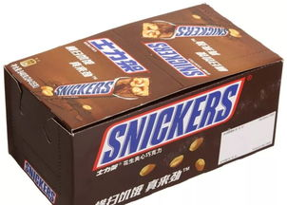
Detailed Reading
even if it's just a Snickers bar (Para.10)
... even though it is only a piece of chocolate of my favorite brand.

Slide 51
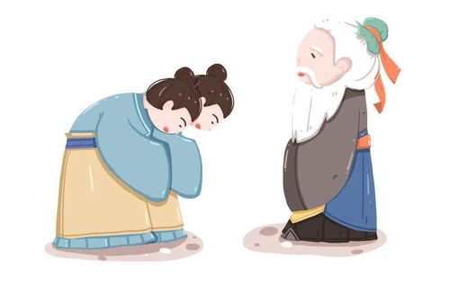
Detailed Reading
Para.11
Concluding paragraph
Do you believe that good manners are infectious?
Is it possible for anyone and everyone to show good manners

Slide 52

Detailed Reading
Now, if we could just get everyone to catch them! (L1, Para 11)
Why does the author use the past form of “can”?
“Could” shows a subjunctive mood which means this is only a wish not a fact.

Slide 53

Now, if we could just get everyone to catch them!
How wonderful it would be if we were able to have everyone behave politely towards one another.
It is the author’s sincere wish for a polite society where everybody would behave politely.

Slide 54
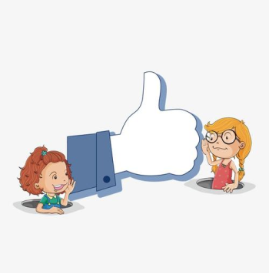
Summary
The essay is an argument on the _______ and __________of good manners.
necessity
significance
In the beginning part, the writer puts forward his viewpoint.
In the last part, the writer concludes that good manners are infectious.
In the next part, the writer raises and proves his opinion.

Slide 55
Summary
The essay is organized chiefly by means of the following method:
1. The main idea is used as the main framework of the text;
2. The deductive method is employed in most of the paragraphs;
3. The writer’s experiences and some typical examples are made good use of as convincing evidence;
4. Some key phrases, each of which stands in a single line, are used as subtitles.

Slide 56
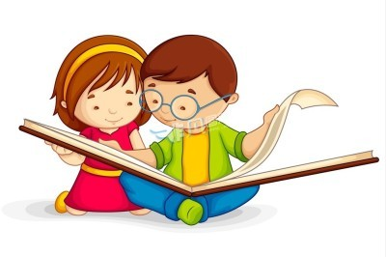
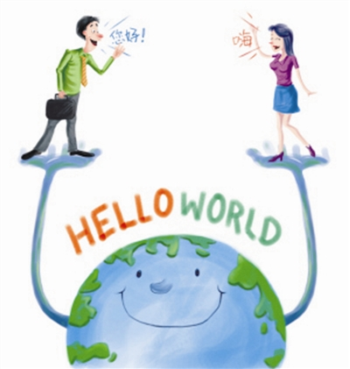
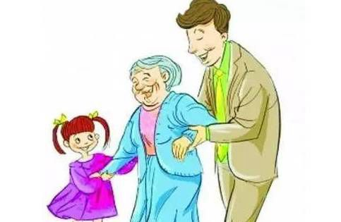
Summary
Friends, classmates, acquaintances
Strangers
manners
Family members

Slide 57
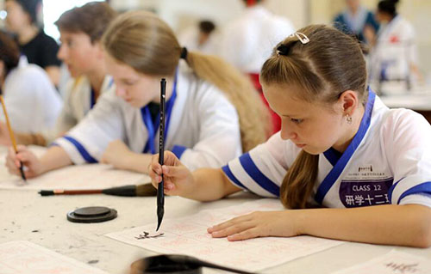
Extension
Famous Quotes and Prose
Manners make the man.
不知礼，无以立也。
这句译文出自孔子《论语》，原文是“不知命，无以为君子也。不知礼，无以立也。不知言，无以知人也。”（不懂得天命，就不能做君子；不知道礼仪，就不能立身处世；不善于分辨别人的话语，就不能真正了解他。）

Slide 58
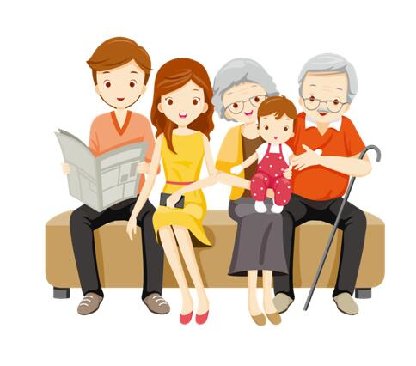
Famous Quotes and Prose
Respect the old, do not deceive the young.
尊重老年人，莫欺少年童。
Etiquette is all-round and quiet.
礼仪周全能息事宁人。

Slide 59
Extension
Famous Quotes idioms
入乡随俗，入国问禁
When in Rome, do as the Romans do.
肚量要宽，讲话要谦。
Be broad-minded and modest in speaking.
君子争礼，小人争嘴。
Gentlemen contend for courtesy and villains contend for words.

Slide 60
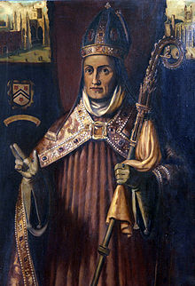


Extension
Manners Makyth Man.
—— William of Wykeham

Slide 61
Assignment
1. Read the article.
A Treatise on Good Manners and Good Breeding by Jonathan Swift.
http://www.en84.com/article-11709-1.html
2. Have a discussion and make a presentation.
Does manners differ in different regions or countries? Use examples to support your views. Please make a 5-minute presentation of this topic in the next class.

Slide 62
Thank You !

