Slide 1

On National Prejudices
Oliver Goldsmith (1763)

Slide 2
Contents
Main idea & Structure
Brief Summary
Language Appreciation
Critical Thinking

Slide 3
Main idea & Structure
Ⅰ

Slide 4
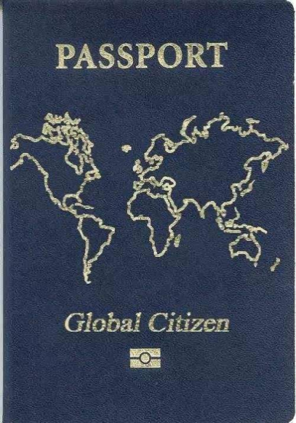
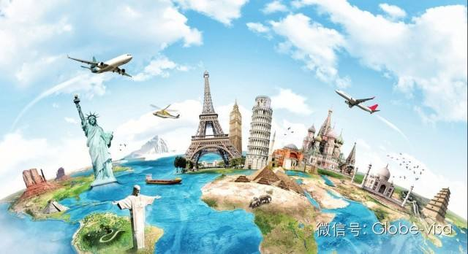
Main idea
Goldsmith argues that it is possible to love one’s own country without hating the peoples of other countries.
Instead of calling himself an Englishman, he claims that he is a citizen of the world.

Slide 5
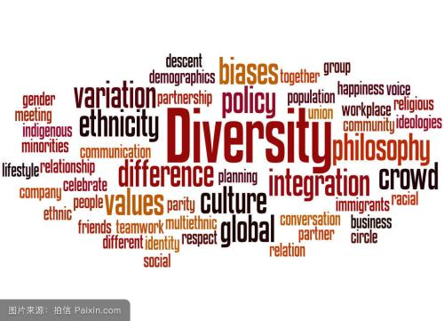
Structure
Part One：para.1-para.5
Dispute
Part Two: para.6-para.9
Thinking

Slide 6
Brief Summary
Ⅱ

Slide 7
I accidentally came across some gentlemen, who were in a dispute about political affairs, and 1________ to me, drawing me in their conversation. Talking of different characters of several European nations, one proud English gentleman declared that the English excelled all the world in bravery, generosity and clemency among 2___________ Dutch, flattering French, drunken and 3__________ Germans, and proud, haughty, and surly 4________. This remark received 5____________ from all the company but me. I would not have ventured to talk in such a 6___________ strain, unless I examined the manners of these people with great care and accuracy to arrive at a more 7_________ judgment. I reflected on the absurd and ridiculous nature of national prejudice and 8_____________. Rather than being a world citizen, we become so much the members of one 9______ society. This prejudice prevails among most kinds of people and it is a gross 10_______ and delusion.
referred
avaricious
gluttonous
Spaniards
approbation
peremptory
impartial
prepossession
petty
fallacy

Slide 8
Language Appreciation
Ⅲ

Slide 9

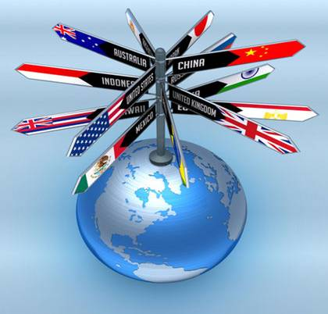
Language Appreciation
1
Selection of Words
2
Figures of Speech

Slide 10
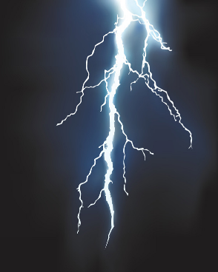

Selection of Words
VS
right word
“lighting”
almost-right word
“lighting bug”

Slide 11
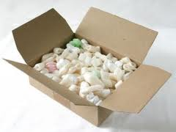
Big or Small?
The Dutch were ____________ avaricious wretches; the French __________ flattering sycophants. (P2,L12)
a parcel of
a set of

Slide 12
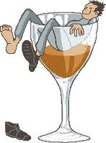
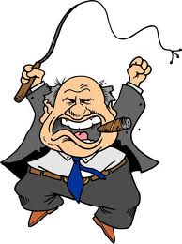

Big or Small?
The Germans were drunken______, and beastly ________; and the Spaniards proud, haughty, and surly___________.
（P2，L13）
sots
gluttons
tyrants

Slide 13
Figures of Speech
Irony
Metaphor
Analogy

Slide 14
Irony
The very learned and judicious remark was received with a general smile of approbation by all the company.(P3, L17)
shallow and biased
chime in with ignorance

Slide 15
Metaphor
The slender vine twists around the sturdy oak for no other reason in the world but because it has not strength sufficient to support itself.(P7,L67)
Those who are apt to boast of national merit and have no merit of their own.
The nation

Slide 16
Analogy
That it (national prejudice) is the growth and love to our country, I will allow, but that it is the natural and necessary growth of it, I absolutely deny. (P8,L73)
Superstition and enthusiasm too are the growth of religion; but who ever took it in his head to affirm that they are the necessary growth of this noble principle? (P8,L73)

Slide 17
Critical Thinking
Ⅳ

Slide 18
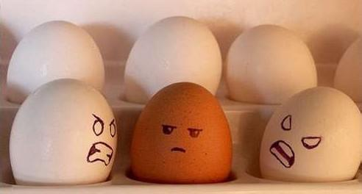
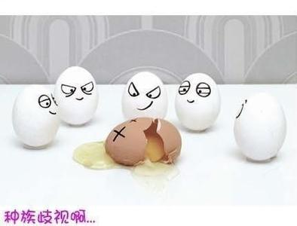
Discussion
1. What is the relationship between patriotism and ethnocentrism?
2. Do Chinese people have any national prejudices over other nations? If the answer is yes, then what should we do?

Slide 19
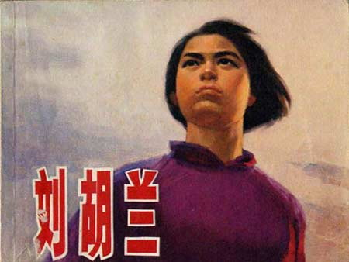

Patriotism covers such attitudes as: pride in its achievements and culture, the desire to preserve its character and the basis of the culture, and identification with other members of the nation.
Ethnocentrism is the tendency to look at the world primarily from the perspective of one's own ethnic culture. One may view other cultures not only as different, but also as inferior, with a great danger of behaving in ways that are damaging to those from other cultures.

Slide 20
The National Prejudice in English Language
Chinese whispers
shanghai
Indian hand
Spanish athlete
Irish Bull
French leave
Dutch courage
Dutch Nightingale
Dutchman
beat the Dutch
极出色、了不起
非人类
以讹传讹
欺骗
干涉，插足
不辞而别，擅离职守
酒后之勇
聒噪的蛙鸣
吹牛大王
荒谬的说法，自相矛盾

Slide 21
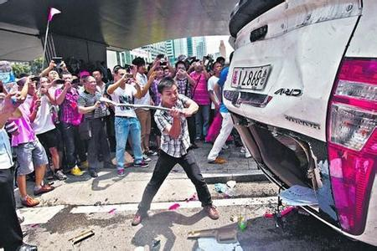
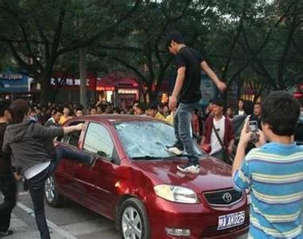

Slide 22
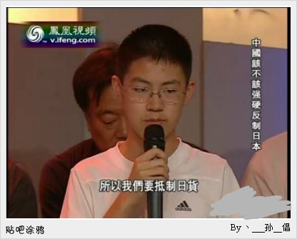
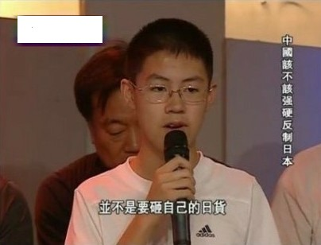
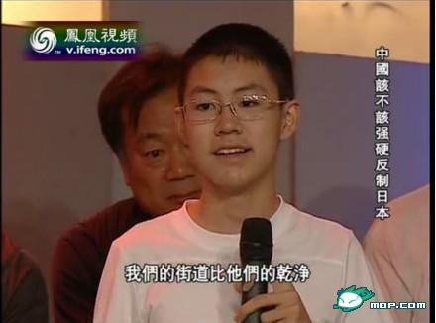
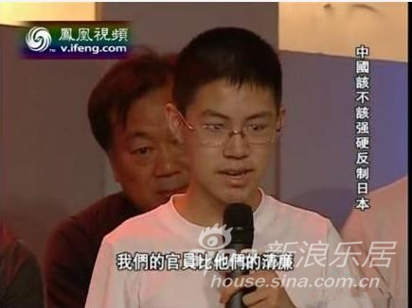

Slide 23

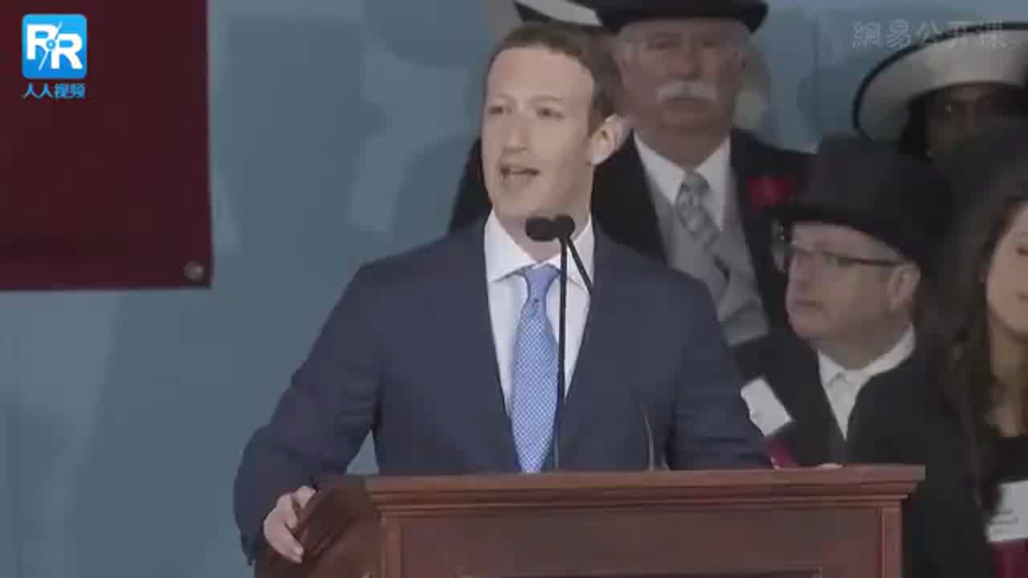
Citizen OF
The World

Slide 24
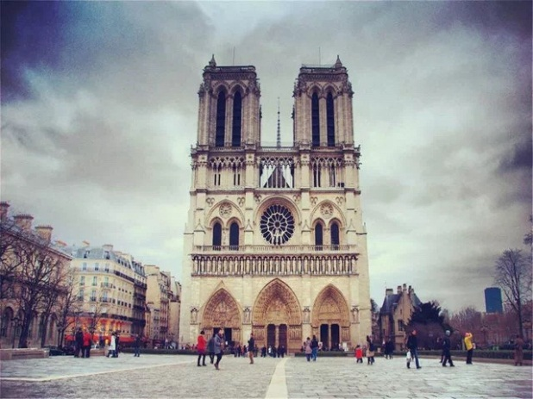
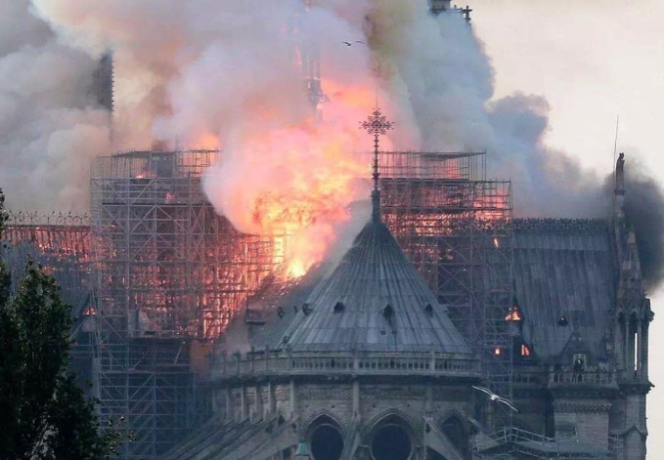
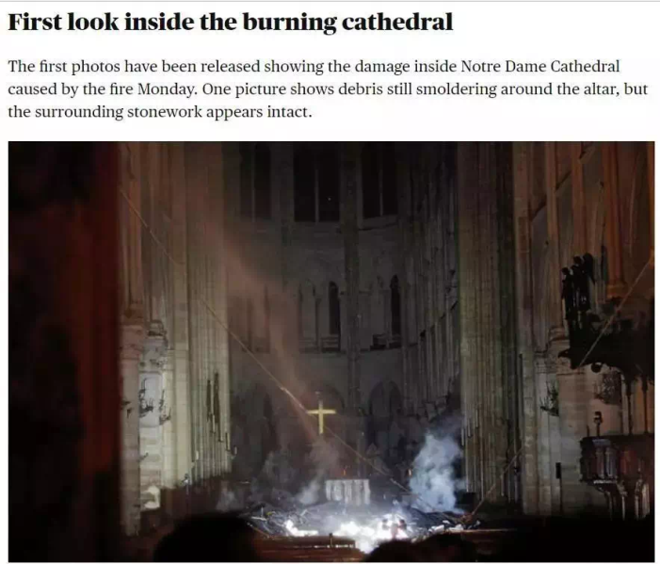
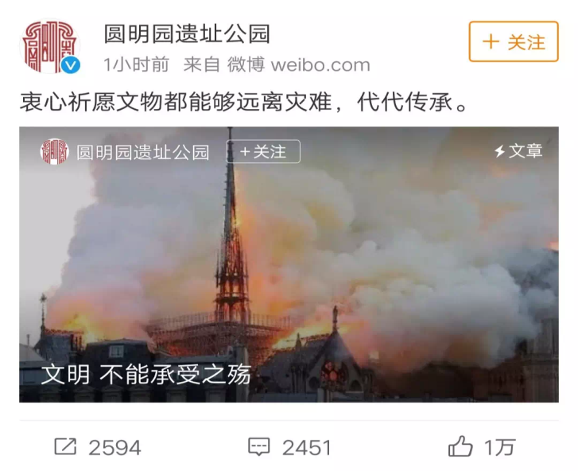
When human civilization collapsed, no one was an outsider.

Slide 25
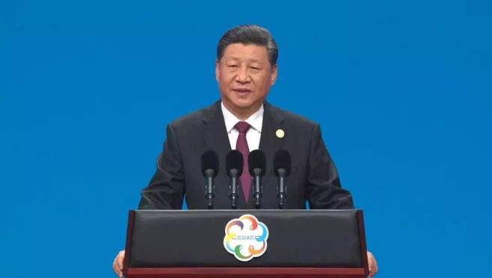

Civilizations only vary as the same way human beings differ in skin color and languages they use. No civilization is superior to others.
China today is more than the country itself. It is very much a part of Asia and the world.

Slide 26
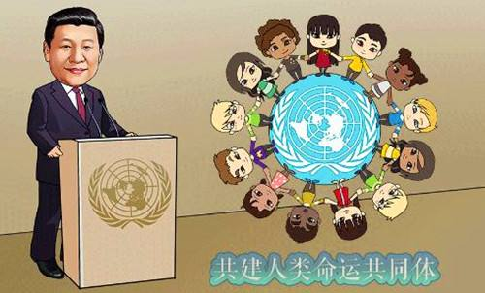
WHAT TO DO
Be generous to all kinds of civilization.
Accept the verified culture and different nations.
Be aware of our world citizenship.

Slide 27
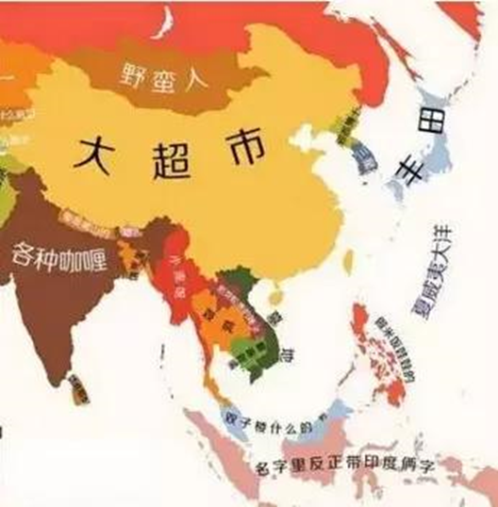
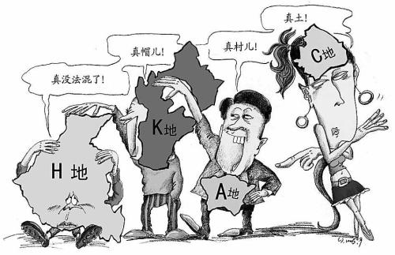
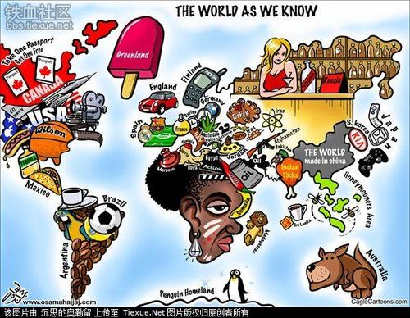
Assignment
International travel often lead people have some prejudices rather than broad minds.
What are the main reasons of this phenomenon?
What do you think people can get better understanding of the countries they visit?
Write an essay of about 250 words to discuss the issue.
(www.pigai.org作业号：1329559)

Slide 28
Thank you for listening!

